Slide 1
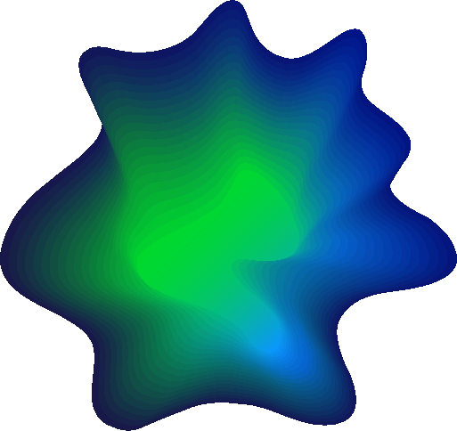
Programing Clinic
Vehicle management
reporting person：Duan Youzhen
reporting time：09.06.2024
Notes:
模板来自于： 第一PPT https://www.1ppt.com/

Slide 2
Project ideas
Basic event flow：
In order to optimise urban traffic, the department would like to analyse the flow of vehicles at different times of the day and identify areas prone to congestion. The system should provide insights to help manage and reduce traffic congestion.
Notes:
模板来自于： 第一PPT https://www.1ppt.com/

Slide 3
Project ideas
Suggested methodology：
There exists a RECORD function in this system to record the licence plate number and then send email notifications to other drivers once a particular vehicle like 120 is spotted at a particular intersection. Once a special vehicle like the 120 is spotted at a certain intersection, an email notification is sent to other drivers.
Notes:
模板来自于： 第一PPT https://www.1ppt.com/

Slide 4
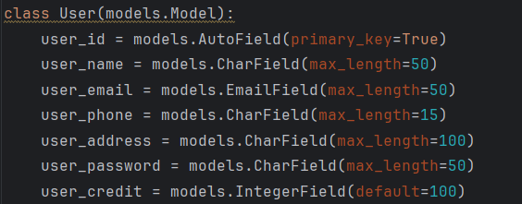
1.Modify the owner's model
Notes:
模板来自于： 第一PPT https://www.1ppt.com/

Slide 5
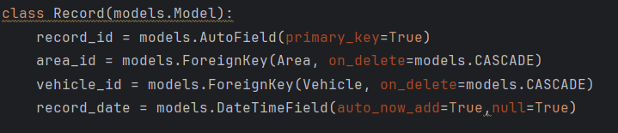
2. Modify the model of registered licence plate number
Add record_date class
Notes:
模板来自于： 第一PPT https://www.1ppt.com/

Slide 6
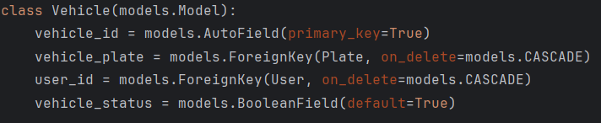
3. Registered licence plate number model
Notes:
模板来自于： 第一PPT https://www.1ppt.com/

Slide 7

4. Emergency vehicle model
Notes:
模板来自于： 第一PPT https://www.1ppt.com/

Slide 8
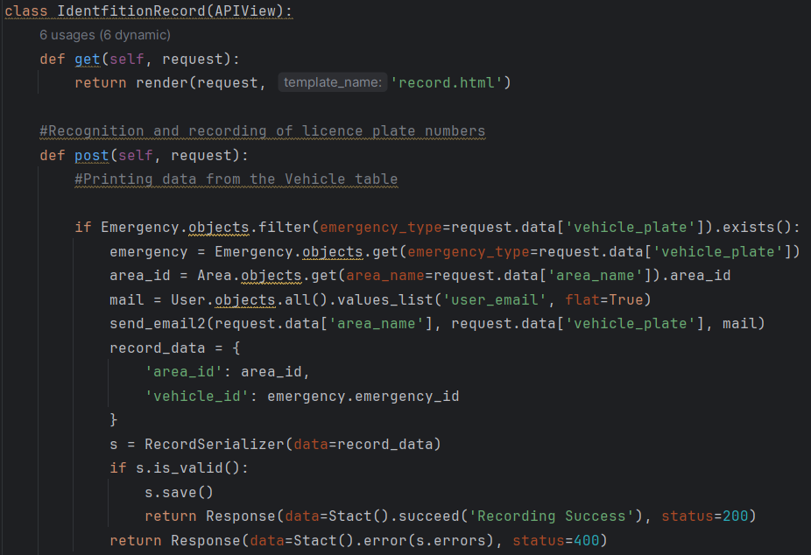
5. Record licence plate number, record the owner
and licence plate number as well as current time
Notes:
模板来自于： 第一PPT https://www.1ppt.com/

Slide 9
6. Count the number of times vehicles appear in each region
in the RECORD table, visualise it, and use the ARIMA model to
predict it, and set the traffic flow in each region not to be
greater than 200, otherwise, send an email notification to the user.
Notes:
模板来自于： 第一PPT https://www.1ppt.com/

Slide 10
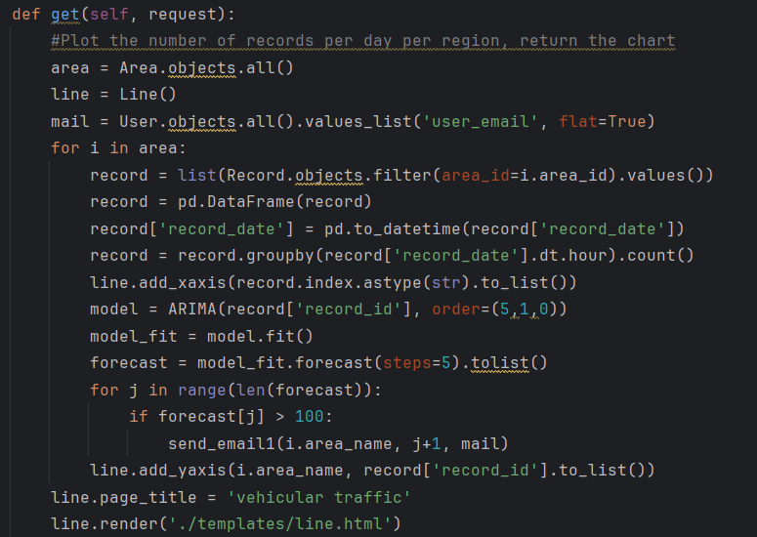
Notes:
模板来自于： 第一PPT https://www.1ppt.com/

Slide 11
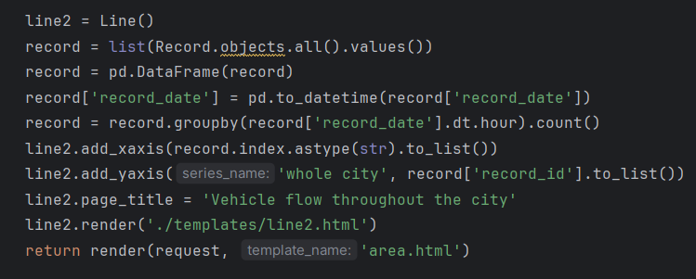
Notes:
模板来自于： 第一PPT https://www.1ppt.com/

Slide 12
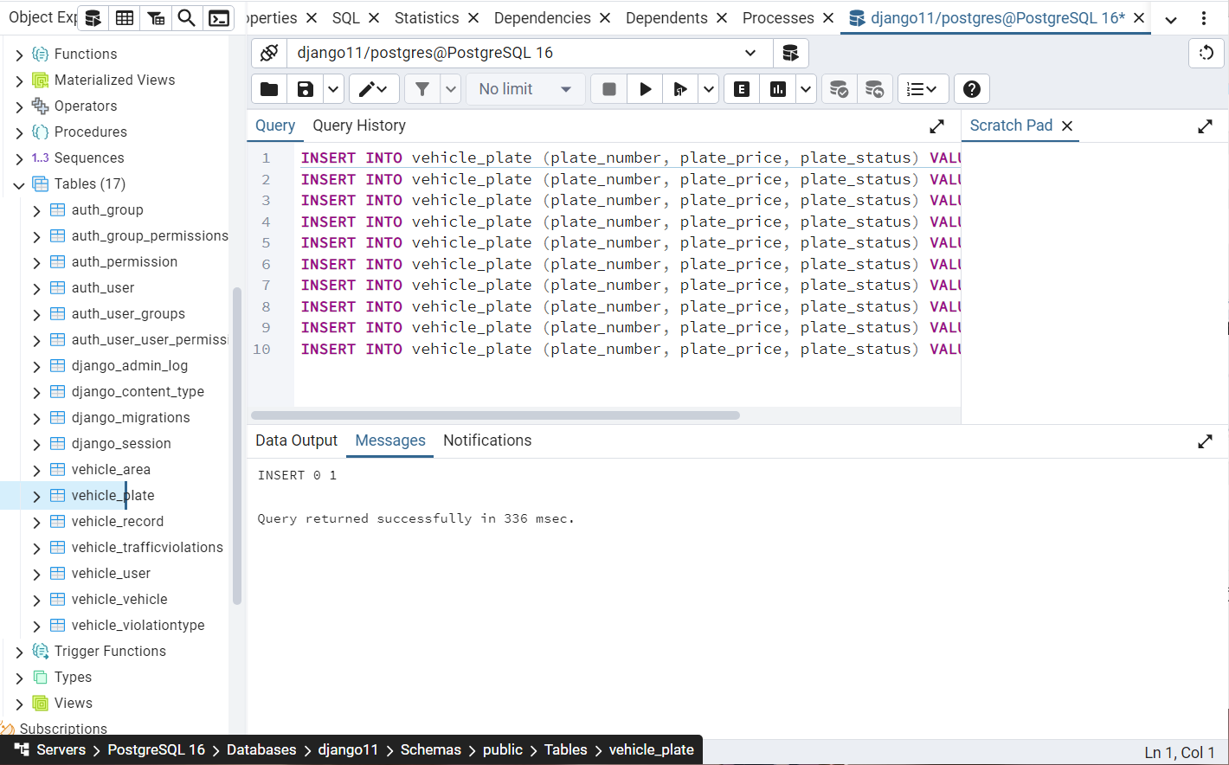
7. Simulating Data in PostgreSQL
Notes:
模板来自于： 第一PPT https://www.1ppt.com/

Slide 13
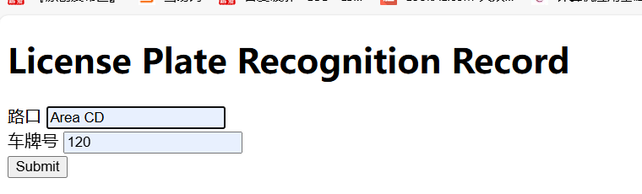
9.Emergency vehicle records
--Post Writes the area with the emergency vehicle
and sends a mailbox to the owner for notification
Notes:
模板来自于： 第一PPT https://www.1ppt.com/

Slide 14
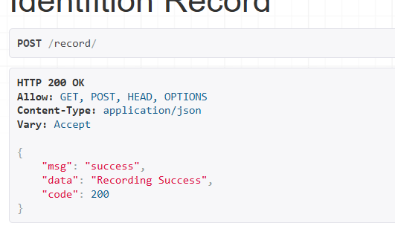
Notes:
模板来自于： 第一PPT https://www.1ppt.com/

Slide 15
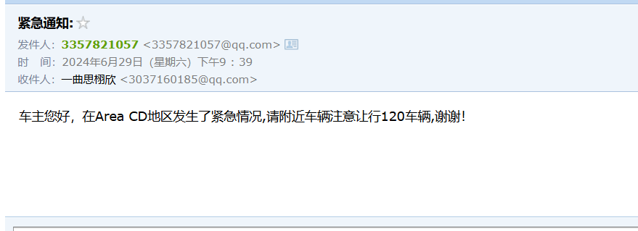
Notes:
模板来自于： 第一PPT https://www.1ppt.com/

Slide 16
DEMO
Notes:
模板来自于： 第一PPT https://www.1ppt.com/

Slide 17
Thanks for watching.

